Slide 1
LCD – Raspberry pi 4 Interfacing
Vy. N – C0776242 – Group 1

Slide 2
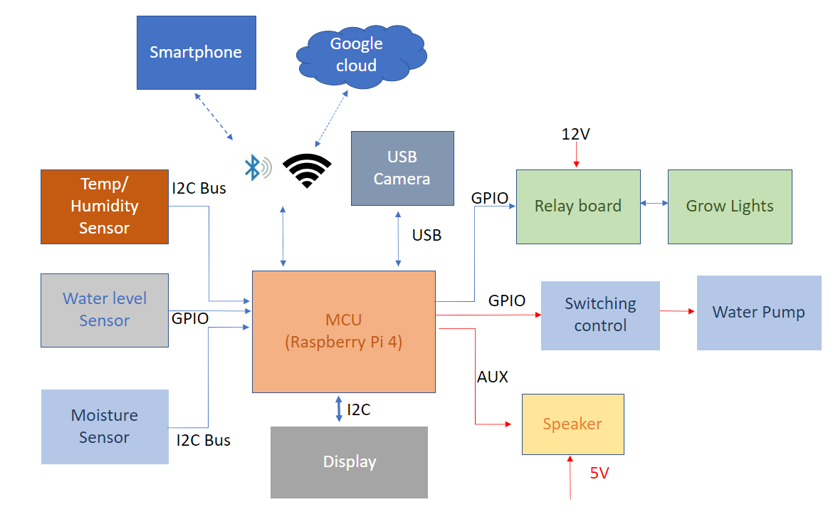
Project summary – Block diagram

Slide 3
Project Summary – Key features
Smartphone control: the device can be monitored and controlled via the BLE system or by smartphone via Wifi and Google Cloud.
Auto-adjusting temperature: with an optional enclosed space, the temperature in each slot of the device can be adjusted to a suitable level for any particular plant.
Auto-adjusting humidity: some plants may enjoy their habitat in a humid environment; our device can replicate the humidifier system’s moist air humidifier system’s moist air-control.
Auto-watering: the plants will never be dried out again with this feature; the device will detect the soil’s humidity and automatically water your plants whenever they need.
Auto-disease-detect: the device will have a camera system that scans the leaves of your plants, then detects any disease happening to the plants, and recommends proper treatment.
Light system: with the LEDs system, the device can save up to 70% of power consumption.
Music player: yes, our device will also have a music function. You wonder why? According to a study, music increases plants’ productivity, and it improves their health and “mood.” (Mazlan, 2020).
Friendly control interface: With a LCD built on, you can easily control your whole garden within a few steps.

Slide 4
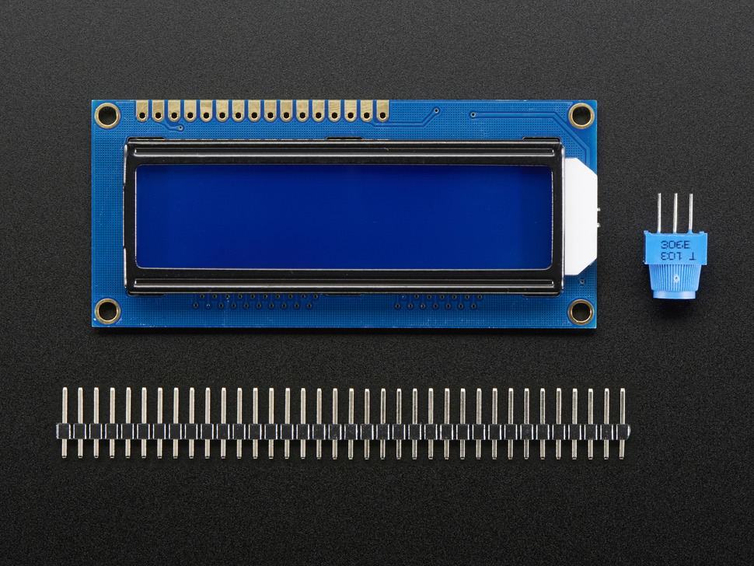
Character LCD - Specification
5 × 8 and 5 × 10 dot matrix possible
Low power operation support:
2.7 to 5.5V
• Wide range of liquid crystal display driver power
3.0 to 11V
• Liquid crystal drive waveform
A (One line frequency AC waveform)
• Correspond to high speed MPU bus interface
2 MHz (when VCC = 5V)
• 4-bit or 8-bit MPU interface enabled
• 80 × 8-bit display RAM (80 characters max.)
• 9,920-bit character generator ROM for a total of 240 character fonts
208 character fonts (5 × 8 dot)
32 character fonts (5 × 10 dot)

Slide 5
Character LCD - Specification
64 × 8-bit character generator RAM
8 character fonts (5 × 8 dot)
4 character fonts (5 × 10 dot)
16-common × 40-segment liquid crystal display driver
Programmable duty cycles
1/8 for one line of 5 × 8 dots with cursor
1/11 for one line of 5 × 10 dots with cursor
1/16 for two lines of 5 × 8 dots with cursor
Wide range of instruction functions:
Display clear, cursor home, display on/off, cursor on/off, display character blink, cursor shift, display shift
Pin function compatibility with HD44780S
Automatic reset circuit that initializes the controller/driver after power on
Internal oscillator with external resistors
Low power consumption

Slide 6
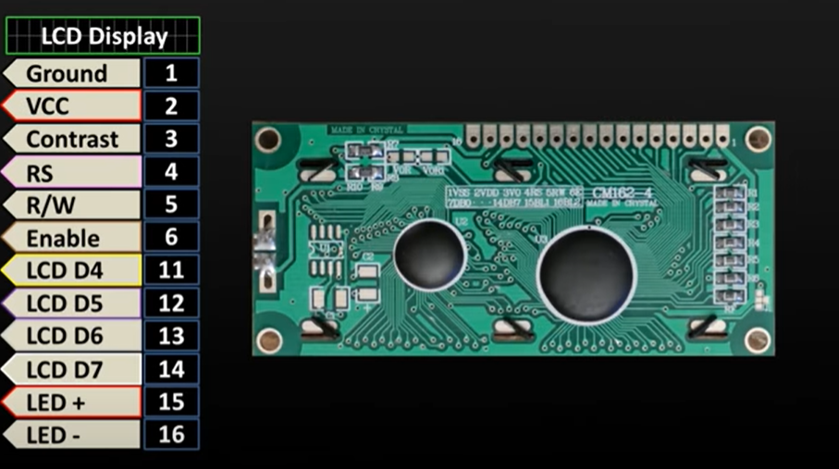
Character LCD - Pinout

Slide 7
Character LCD – Raspberry pi – Normal connection
From the LCD pins to Raspberry pi 4, we can connect:
Pin #1 of the LCD goes to ground
Pin #2 of the LCD goes to +5V
Pin #3 (Vo) connects to the middle of the potentiometer
Pin #4 (RS) connects to the Cobbler #22
Pin #5 (RW) goes to ground
Pin #6 (EN) connects to Cobbler #17
Skip LCD Pins #7, #8, #9 and #10
Pin #11 (D4) connects to cobbler #25
Pin #12 (D5) connects to Cobbler #24
Pin #13 (D6) connects to Cobber #23
Pin #14 (D7) connects to Cobber #18
Pin #15 (LED +) goes to +5V (red wire)
Pin #16 (LED -) goes to ground (black wire)
One disadvantage is this method taking too many pins.

Slide 8
Character LCD – MCP230XX chip
To use an MCP230xx chip with a character LCD you will need to wire the MCP chip to your board's I2C pins, and then wire the LCD to the MCP chip.
For advanced users, this project can be used for general purpose I/O expansion, the MCP23008 has 8 i/o pins (7 are connected) with optional pullups, the SPI 74HC595 has 7 outputs.
The MCP23008 and MCP23017 family of chips provide an easy way to add extra digital inputs and outputs to your development board. These chips are controlled with an I2C connection and add 8 or 16 extra digital pins that can act as outputs or inputs (even with optional pull-up resistors).

Slide 9
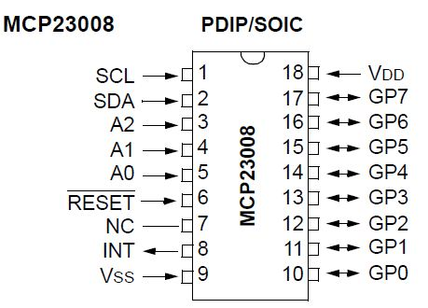
Character LCD – MCP23008 chip – pinout

Slide 10
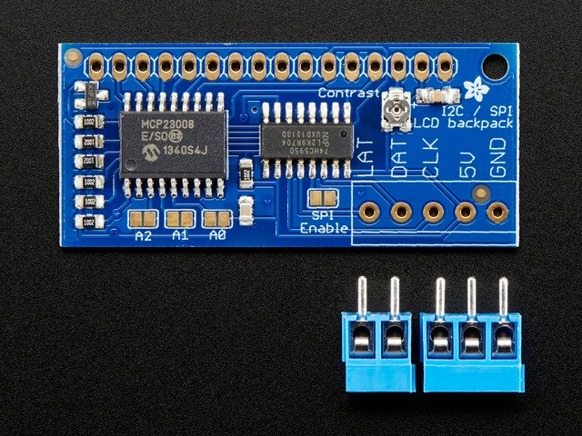
Character LCD – I2C/SPI LCD Backpack

Slide 11
Character LCD – I2C/SPI LCD Backpack
I2c/SPI LCD backpack is using MCP23008 to expand the digitals pins that can communicate with the raspberry pi via I2C or SPI communication. Saving the digitals pin on raspberry pi for other usage.

Slide 12
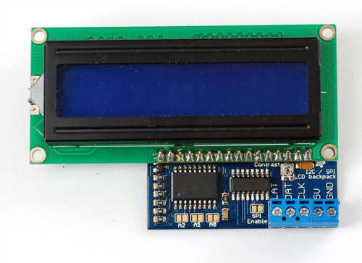
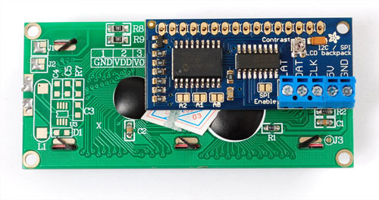
Character LCD – I2C/SPI LCD Backpack soldering
There are two options, you can tuck the backpack behind the LCD
Or solder it so it's to the side, this way it's thinner.
Make sure that you line up pin 1 of the backpack with pin 1 of the display. Pin 1 is on the right side of the backpack closest to the Adafruit logo

Slide 13
I2c Communication – Brief summary
Inter-Integrated Circuit (IIC or I2 C) is a two-wire bus that was designed by Philips in the 1980s to interface microprocessors or microcontrollers to low-speed peripheral devices. A master device, controls the bus, and many addressable slave devices can be attached to the same two wires. It has remained popular over the years, mainly because of its relative simplicity and breadth of adoption.
Only two signal lines are required for communication, the Serial Data (SDA) line for the bidirectional transmission of data, and the Serial Clock (SCL) line.
Each device on the bus can act as a master or a slave. The master device is the one that initiates communication, and the slave device is the one that responds.
Each slave device attached to the bus is pre-assigned a unique address, which is in either 7-bit or 10-bit form. In the following examples, 7-bit addressing is used, i.e., 0x00 to 0x7F (2⁷ = 128₁₀ = 0x80)
It has true multi-master bus facilities, including collision detection and arbitration if two or more master devices activate at once

Slide 14
Raspberry pi 4 – I2C configuration
Method 1: Installing Kernel Support (with Raspi-Config)
Run sudo raspi-config and follow the prompts to install i2c support for the ARM core and linux kernel
Go to Interfacing Options.
On older versions, look under Advanced.
Then choose I2C.
Enable!

Slide 15
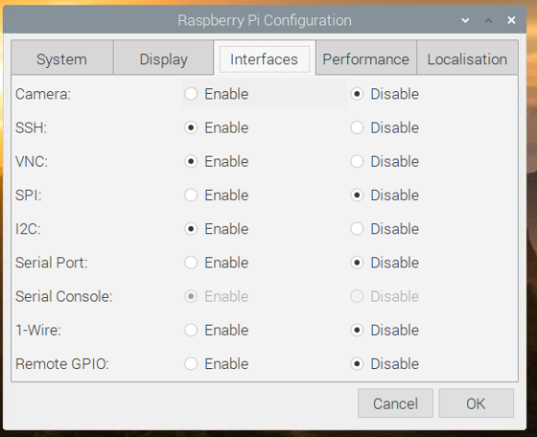
Raspberry pi 4 – I2C configuration (cont.)
Method 2: using VNC and enable i2c
On raspberry pi terminal (log in via Putty or cmd prompt on Windows, or terminal on Linux )Type vncserver
On desktop machine, go to vnc and connect to raspberry pi
Then go to raspberry pi icon → Preferences → Raspberry Pi Configuration → Interfaces → Enable i2c.

Slide 16
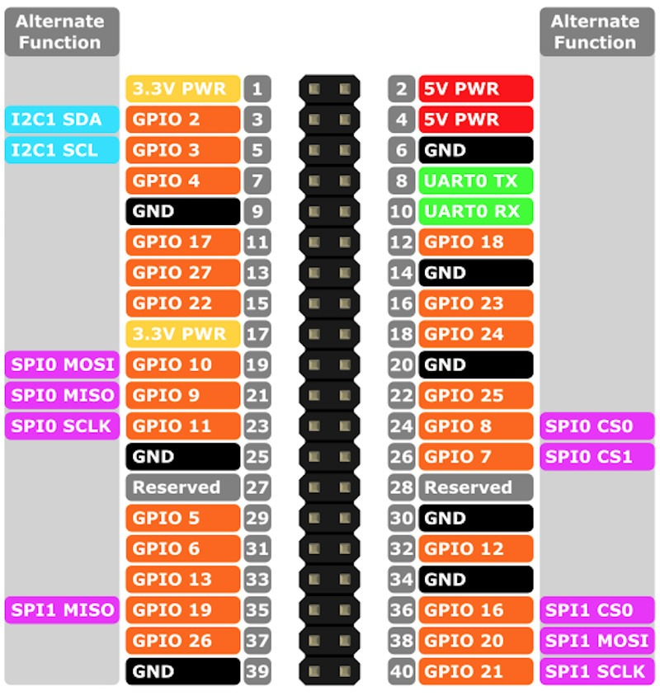
Raspberry pi 4 - I2C/SPI LCD pin connection
5V to your 5V power pin - don't use 3.3V power, the LCD needs 5V for contrast! The I2C pullups are fairly weak so you can use use 3.3V logic for SDA/SCL even if the board is powered with 5V
GND to Ground
DAT (SDA) to I2C Data (pin 2)
CLK (SCL) to I2C Clock (pin 3)

Slide 17
Raspberry pi 4 - I2C/SPI LCD testing
Now on the command prompt (or terminal) of the raspberry pi
Type sudo i2cdetect -y 1. This shows that two I2C addresses are in use
Using i2cdumb with the address show from the i2c address about to access the register information of the device.

Slide 18
Raspberry pi 4 – LCD i2c Interfacing.
In this section, we will talk about the LCD and Raspberry interfacing via I2c communication.
The idea of this system will be illustrated like the block diagram below:
LCD Display
(HD44780)
I2C/SPI – Backpack (MCP23008)
Raspberry Pi 4
GPIO
I2C

Slide 19
Raspberry pi 4 – LCD I2C Interfacing. Supported library
WiringPI library:
WiringPi is an Arduino wiring-like library written in C and released under the GNU LGPLv3 license which is usable from C and C++ and many other languages with suitable wrappers
You may be familiar with the Arduino… Briefly; Arduino is really two things; one is a hardware platform, the other software, and part of the software is a package called Wiring. Wiring is the core of the input and output for the Arduino, so I thought it would be good to replicate that functionality (or a good usable subset) on the Raspberry Pi.
WiringPi includes a command-line utility gpio which can be used to program and setup the GPIO pins. You can use this to read and write the pins and even use it to control them from shell scripts.

Slide 20
Raspberry pi 4 – LCD I2C Interfacing. In C.
In this section, we will explain about the library and functions that we used in order to control the LCD (HD44780).
#include <wiringPiI2C.h>
#include <wiringPi.h>
#include <stdlib.h>
#include <stdio.h>
The code is developed by Lewis Loflin, for more infimation, following this site

Slide 21
Raspberry pi 4 – LCD I2C Interfacing. <wiringPiI2c.h>
<wiringPiI2C.h>
Before you can use the I2C interface, you may need to use the gpio utility to load the I2C drivers into the kernel:
gpio load i2c
If you need a baud rate other than the default 100Kbps, then you can supply this on the command-line:
gpio load i2c 1000
will set the baud rate to 1000Kbps – ie. 1,000,000 bps. (K here is times 1000)
To use the I2C library, you need to:
#include <wiringPiI2C.h>
in your program. Programs need to be linked with -lwiringPi as usual.

Slide 22
Raspberry pi 4 – LCD I2C Interfacing. <wiringPiI2c.h> - functions
int wiringPiI2CSetup (int devId) ;
This initialises the I2C system with your given device identifier. The ID is the I2C number of the device and you can use the i2cdetect program to find this out. wiringPiI2CSetup() will work out which revision Raspberry Pi you have and open the appropriate device in /dev.
The return value is the standard Linux filehandle, or -1 if any error – in which case, you can consult errno as usual.
int wiringPiI2CRead (int fd) ;
Simple device read. Some devices present data when you read them without having to do any register transactions.
int wiringPiI2CWrite (int fd, int data) ;
Simple device write. Some devices accept data this way without needing to access any internal registers.

Slide 23
Raspberry pi 4 – LCD I2C Interfacing. <wiringPiI2c.h> - functions (cnt.)
int wiringPiI2CWriteReg8 (int fd, int reg, int data) ;
int wiringPiI2CWriteReg16 (int fd, int reg, int data) ;
These write an 8 or 16-bit data value into the device register indicated.
int wiringPiI2CReadReg8 (int fd, int reg) ;
int wiringPiI2CReadReg16 (int fd, int reg) ;
These read an 8 or 16-bit value from the device register indicated.

Slide 24
Raspberry pi 4 – LCD I2C Interfacing. Custom functions
// added by Lewis
void typeInt(int i);
void typeFloat(float myFloat);
void lcdLoc(int line); //move cursor
void ClrLcd(void); // clr LCD return home
void typeln(const char *s);
void typeChar(char val

Slide 25
Raspberry pi 4 – LCD I2C Interfacing. Custom functions
void typeInt(int i);
void typeFloat(float myFloat);
TypeFloat() and typeInt() functions use the sprintf() function to convert the integers and floats to as string. Then both are sent to typeln() function which needs a little explanation
In fact we can send a simple text string director to the typeln() function: typeln("Hello world!").

Slide 26
Raspberry pi 4 – LCD I2C Interfacing. Custom functions
void lcdLoc(int line); //move cursor
void ClrLcd(void); // clr LCD return home
lcdLoc() sets the cursor location for the next character even is programmed to display no blinking cursor. Ox80 (LINE1) is the address for ROW 0 COL 0 while 0xC0 (LINE2) is ROW 1 COL 0.
Assuming a 2-line display and I wanted send a "F" three places to the right on the first line would be lcdLoc(LINE1 + 3).

Slide 27
Raspberry pi 4 – LCD I2C Interfacing. Custom functions
// this allows use of any size string void typeln(const char *s) { while ( *s ) lcd_byte(*(s++), LCD_CHR); }
The function typeln() will output to the display via lcd_byte() function one character at a time incrementing the address pointer "s" until the null character is reached terminating the "while" loop.

Slide 28
Raspberry pi 4 – LCD I2C Interfacing. Code
Transfer the code from desktop to raspberry pi. Or you can create the source file directly on raspberry pi by using touch command
~laptop: scp lcd.c pi@192.168.2.33:~/Project
Checking the content of the code by using:
pi@raspberrypi:~/Project $ nano lcd.c
Following pages are the source code: lcd.c

Slide 29
Raspberry pi 4 – LCD I2C Interfacing. Code
#include <wiringPiI2C.h> #include <wiringPi.h> #include <stdlib.h> #include <stdio.h> // Define some device parameters #define I2C_ADDR 0x27 // I2C device address // Define some device constants #define LCD_CHR 1 // Mode - Sending data #define LCD_CMD 0 // Mode - Sending command #define LINE1 0x80 // 1st line #define LINE2 0xC0 // 2nd line #define LCD_BACKLIGHT 0x08 // On // LCD_BACKLIGHT = 0x00 # Off #define ENABLE 0b00000100 // Enable bit

Slide 30
Raspberry pi 4 – LCD I2C Interfacing. Code
void lcd_init(void); void lcd_byte(int bits, int mode); void lcd_toggle_enable(int bits); // added by Lewis void typeInt(int i); void typeFloat(float myFloat); void lcdLoc(int line); //move cursor void ClrLcd(void); // clr LCD return home void typeln(const char *s); void typeChar(char val); int fd; // seen by all subroutines

Slide 31
Raspberry pi 4 – LCD I2C Interfacing. Code
int main() { if (wiringPiSetup () == -1) exit (1); fd = wiringPiI2CSetup(I2C_ADDR); lcd_init(); // setup LCD char array1[] = "Hello everyone!"; while (1) { lcdLoc(LINE1); typeln("Testing LCD"); lcdLoc(LINE2); typeln("Using wiringPI"); delay(2000); ClrLcd(); lcdLoc(LINE1); typeln("I2c Programmed"); lcdLoc(LINE2); typeln("in C not Python.") } return 0; }

Slide 32
Raspberry pi 4 – LCD I2C Interfacing. Code
// float to string void typeFloat(float myFloat) { char buffer[20]; sprintf(buffer, "%4.2f", myFloat); typeln(buffer); } // int to string void typeInt(int i) { char array1[20]; sprintf(array1, "%d", i); typeln(array1); } // clr lcd go home loc 0x80 void ClrLcd(void) { lcd_byte(0x01, LCD_CMD); lcd_byte(0x02, LCD_CMD); } // go to location on LCD void lcdLoc(int line) { lcd_byte(line, LCD_CMD); } // out char to LCD at current position void typeChar(char val) { lcd_byte(val, LCD_CHR); }

Slide 33
Raspberry pi 4 – LCD I2C Interfacing. Code
// this allows use of any size string void typeln(const char *s) { while ( *s ) lcd_byte(*(s++), LCD_CHR); } void lcd_byte(int bits, int mode) { //Send byte to data pins // bits = the data // mode = 1 for data, 0 for command int bits_high; int bits_low; // uses the two half byte writes to LCD bits_high = mode | (bits & 0xF0) | LCD_BACKLIGHT ; bits_low = mode | ((bits << 4) & 0xF0) | LCD_BACKLIGHT ; // High bits wiringPiI2CReadReg8(fd, bits_high); lcd_toggle_enable(bits_high); // Low bits wiringPiI2CReadReg8(fd, bits_low); lcd_toggle_enable(bits_low); }

Slide 34
Raspberry pi 4 – LCD I2C Interfacing. Code
void lcd_toggle_enable(int bits) { // Toggle enable pin on LCD display delayMicroseconds(500); wiringPiI2CReadReg8(fd, (bits | ENABLE)); delayMicroseconds(500); wiringPiI2CReadReg8(fd, (bits & ~ENABLE)); delayMicroseconds(500); } void lcd_init() { // Initialise display lcd_byte(0x33, LCD_CMD); // Initialise lcd_byte(0x32, LCD_CMD); // Initialise lcd_byte(0x06, LCD_CMD); // Cursor move direction lcd_byte(0x0C, LCD_CMD); // 0x0F On, Blink Off lcd_byte(0x28, LCD_CMD); // Data length, number of lines, font size lcd_byte(0x01, LCD_CMD); // Clear display delayMicroseconds(500); }

Slide 35
Raspberry pi 4 – LCD I2C Interfacing. Compile and Run.
Compiling and Executing the code:
By using this command, we can compiling the c code:
pi@raspberrypi:~/Project $ gcc -o LCD LCD.c -l wiringPi
Running the code:
pi@raspberrypi:~/Project $ ./LCD

Slide 36
Raspberry pi 4 – LCD I2C Interfacing. Demonstration
Result:
pi@raspberrypi:~/Project $ gcc -o LCD lcd.c -l wiringPi pi@raspberrypi:~/Project $

Slide 37
Bibliography
Ada, L., Dicola, T., & Rembor, K. (n.d.). I2C/SPI LCD Backpack. Adafruit. Retrieved June 28, 2021, from https://learn.adafruit.com/i2c-spi-lcd-backpack/overview
Adafruit. (n.d.). Raspberry Pi Char LCD Plate. Adafruit. Retrieved June 28, 2021, from https://learn.adafruit.com/character-lcd-with-raspberry-pi-or-beaglebone-black/raspberry-pi-char-lcd-plate
Loflin, L. (2018). I2C LCD to Raspberry Pi in C. bristolwatch. Retrieved June 28, 2021, from https://www.bristolwatch.com/rpi/i2clcd.htm
Monk, S., & Ada, L. (n.d.). Adafruit's Raspberry Pi Lesson 4. GPIO Setup. Adafruit. Retrieved June 28, 2021, from https://learn.adafruit.com/adafruits-raspberry-pi-lesson-4-gpio-setup/the-gpio-connector

